Slide 1

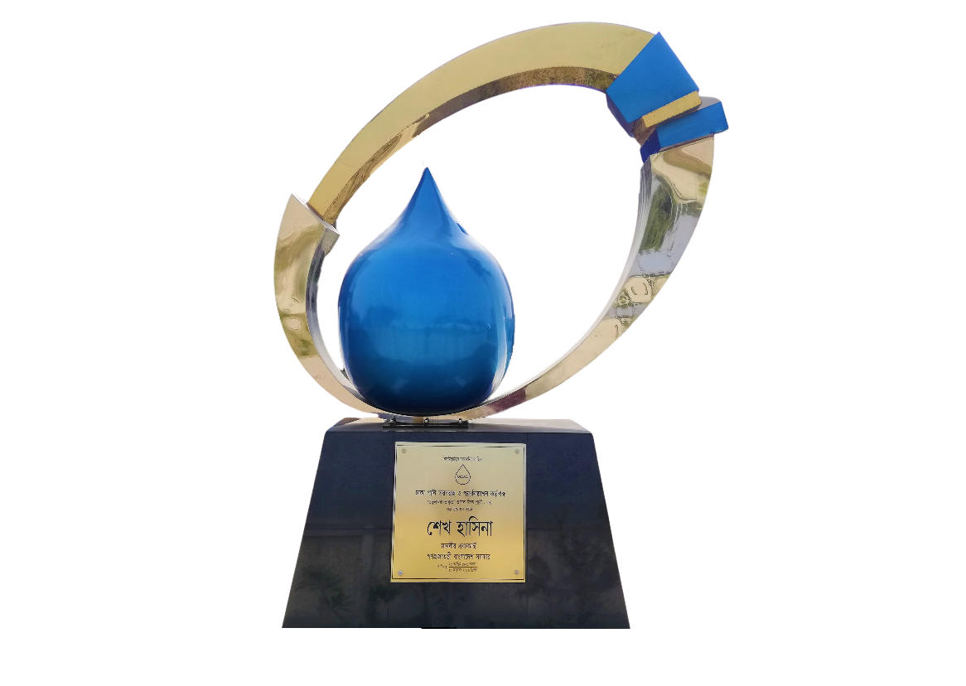
CENTRAL SCADA SYESTEM OVERVIEW OF SAVAR-KERANIGANJ WELLFIELD PLANT DHAKA WASA PRESENTED BY MASHUDUL ALAM, EXECUTIVE ENGINEER DATE: JANUARY 25, 2022.

Slide 2
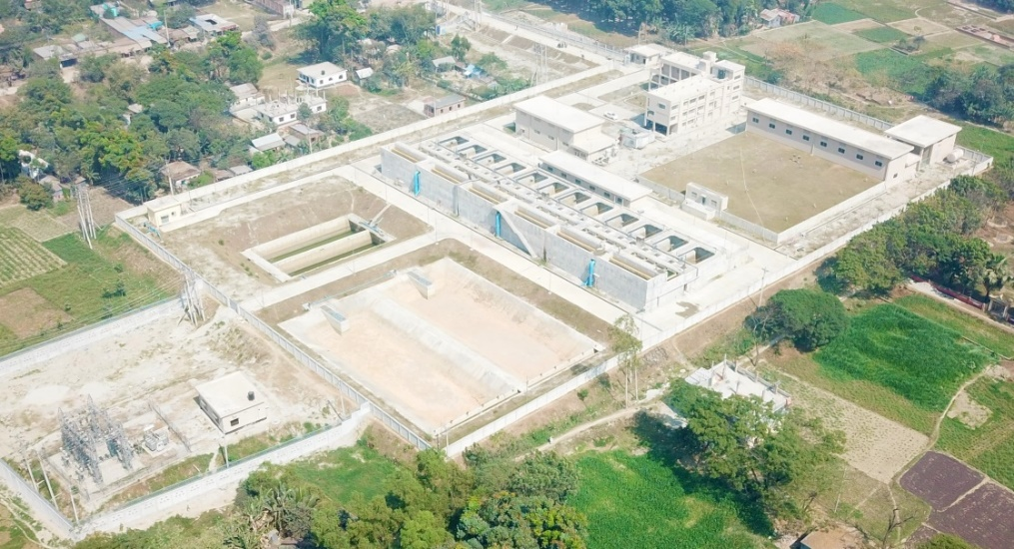
OBJECTIVE
Supply 150 MLD i.e. 15 Cr. Liter Safe Potable Water Daily to Mitigate Water Scarcity in Mirpur Area.

Slide 3
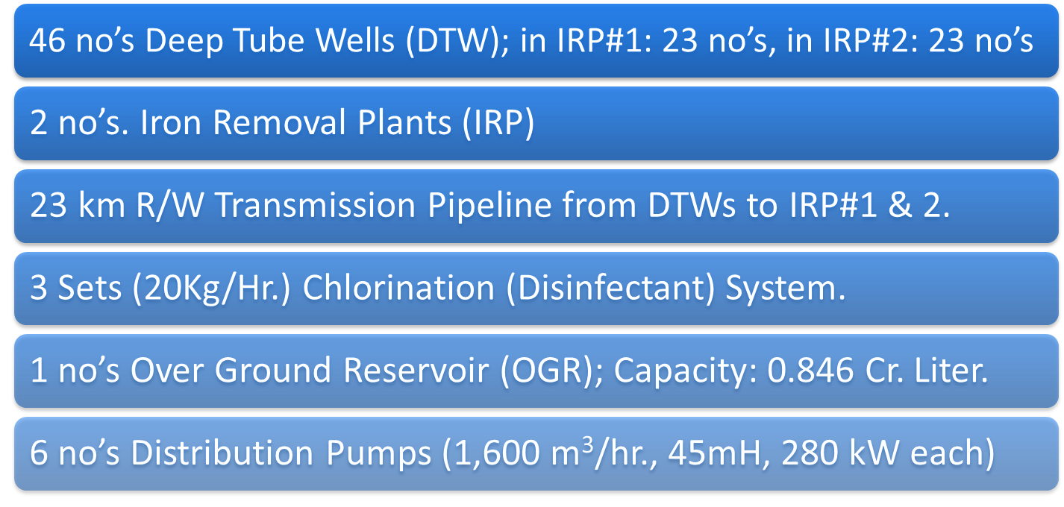
MAJOR INSTALLATIONS & FACILITIES

Slide 4
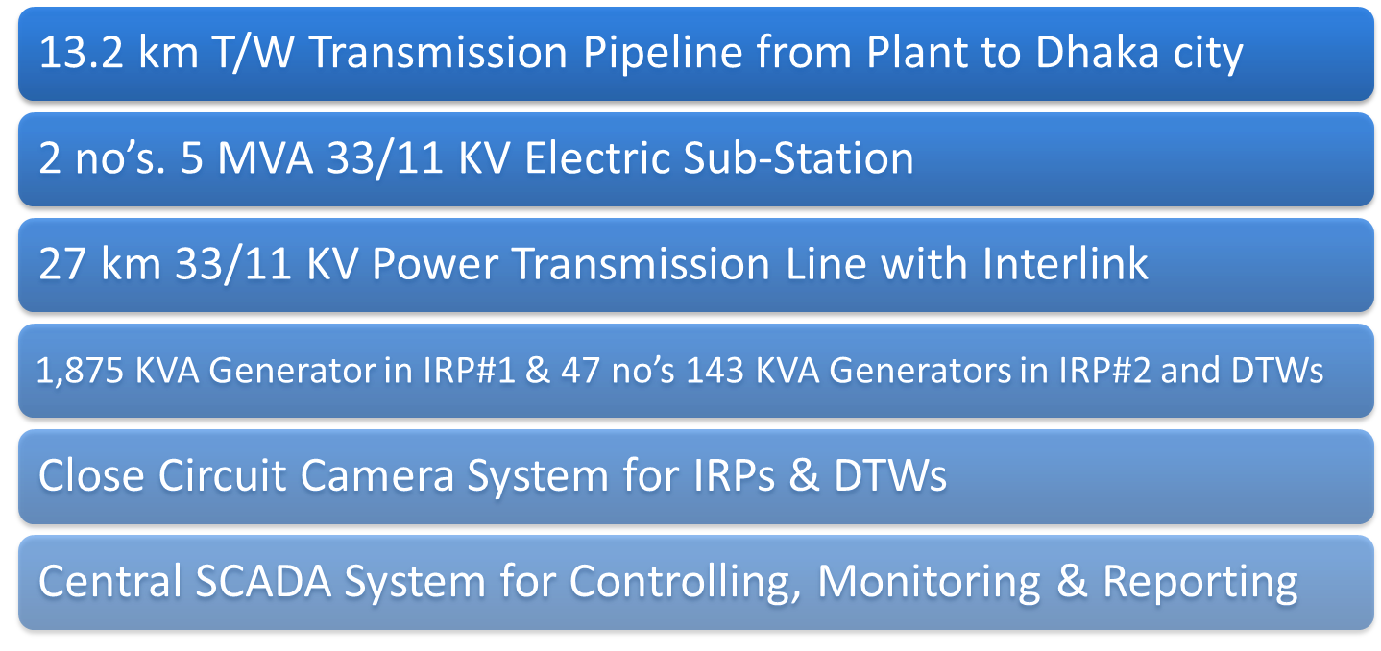
MAJOR INSTALLATIONS & FACILITIES (CONT.)

Slide 5
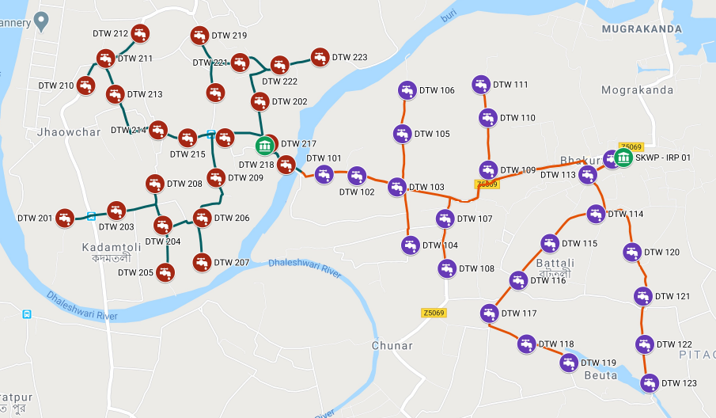
LOCATION MAP OF DTWS

Slide 6
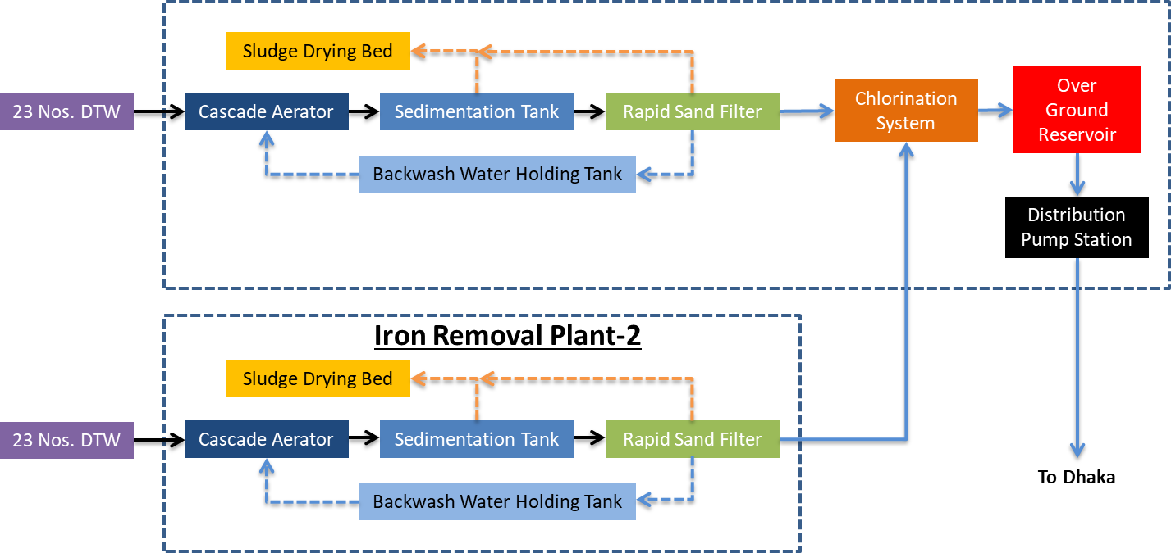
PLANT PROCESS - BLOCK DIAGRAM

Slide 7
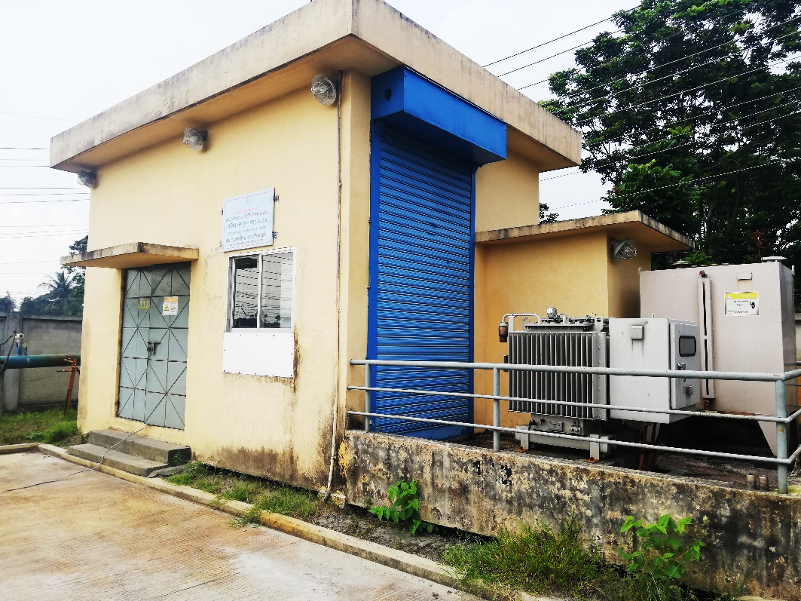
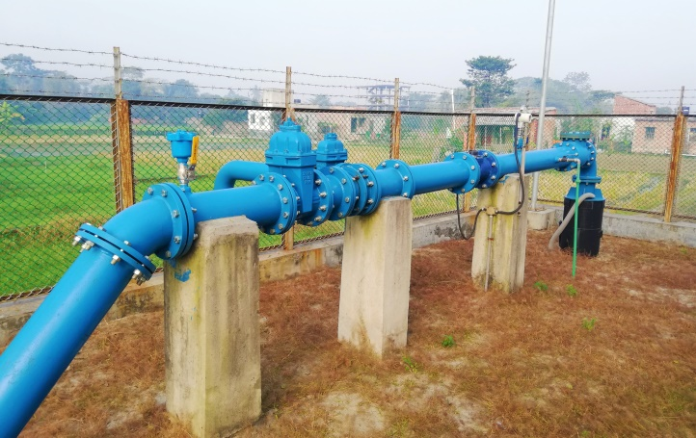
DEEP TUBE WELL (DTW)
The Source of Raw Water for the Iron Removal Plant
46 no’s DTWs;
IRP#1:23 no’s, IRP#2: 23 no’s
Pump Design Head: 60m
Pump Design Flow: 204 m³/h
Pump Motor Power: 55kW

Slide 8
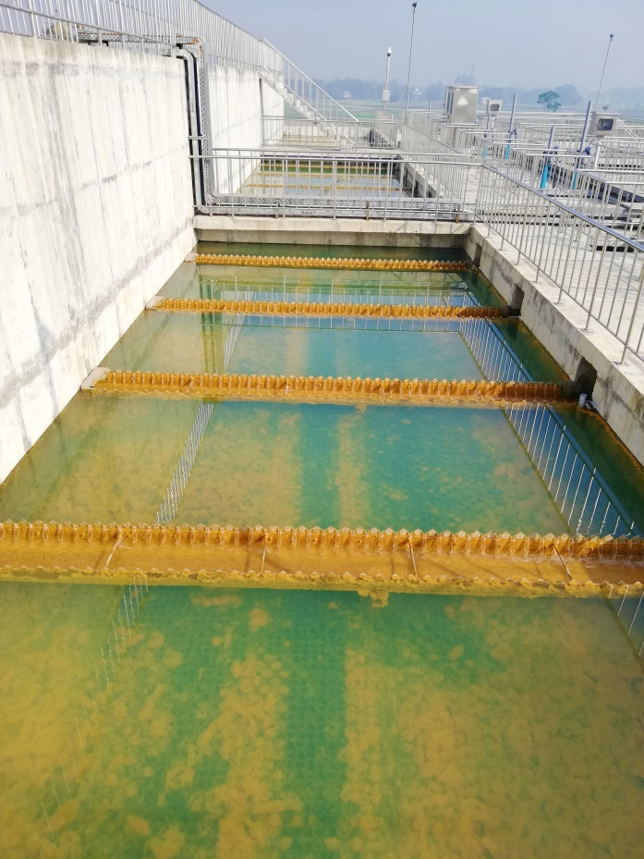
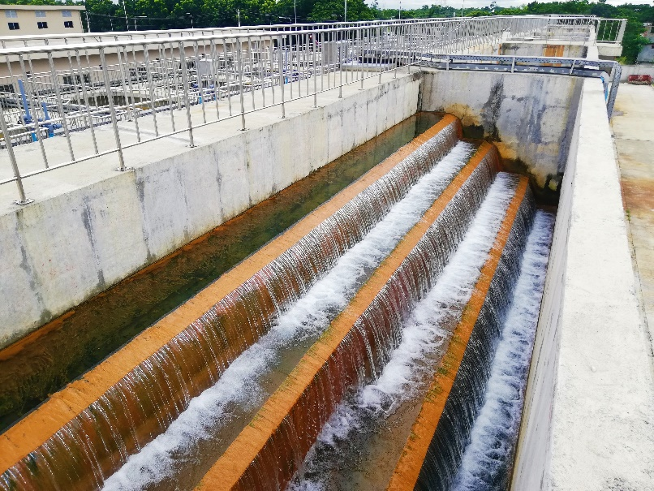
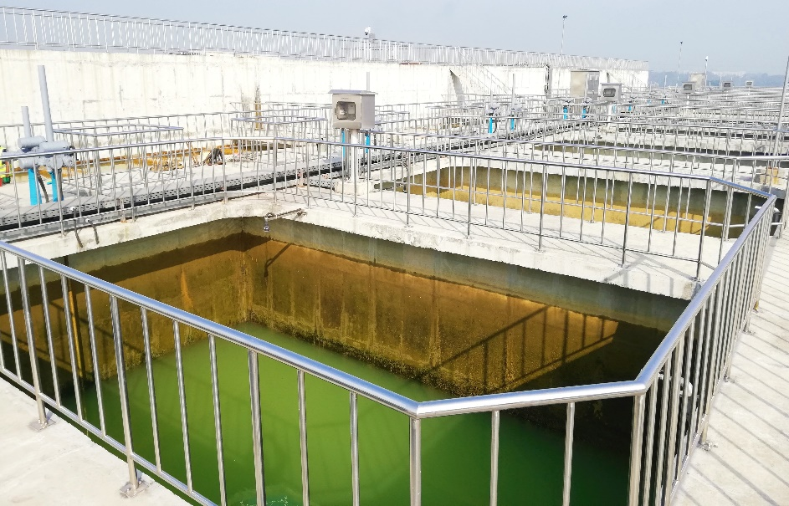
IRON REMOVAL PLANT (IRP)
Divided into 5 Main Parts:
Cascade Aerator
Sedimentation Tank
Rapid Sand Filter

Slide 9
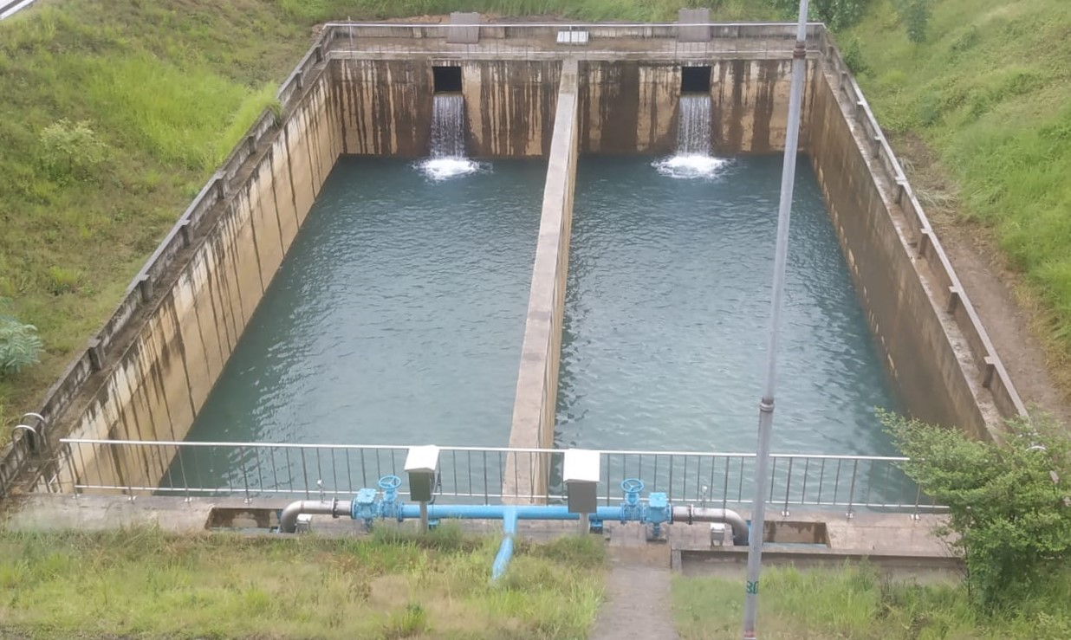
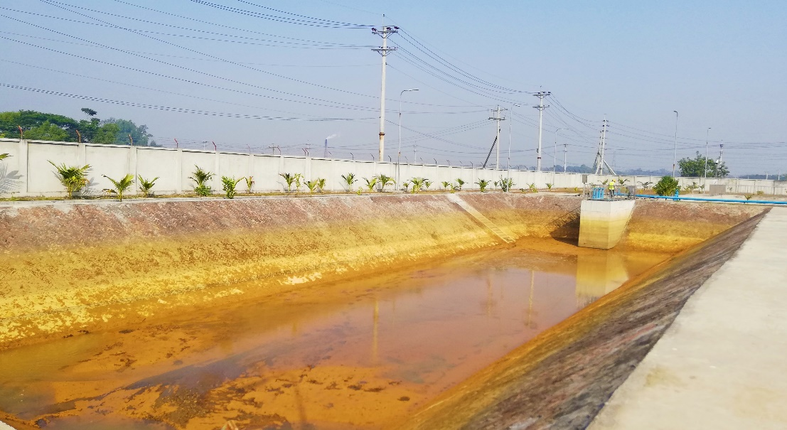
IRON REMOVAL PLANT (IRP)
Divided into 5 Main Parts (Cont.):
Backwash Water Holding Tank
Sludge Drying Bed

Slide 10
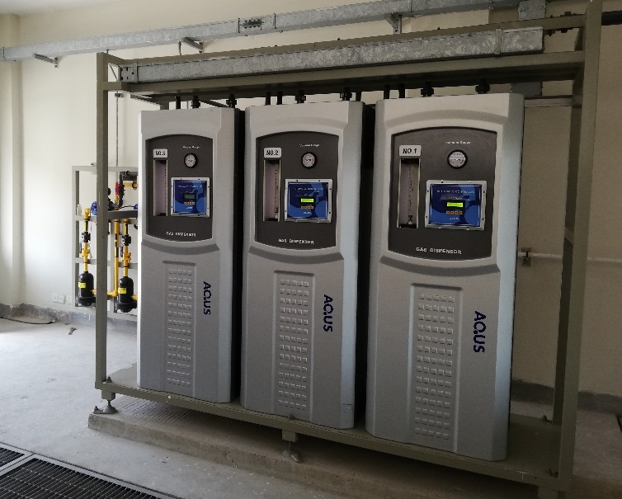
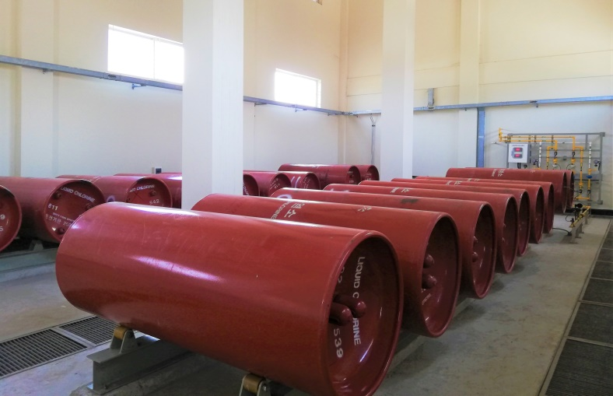
CHLORINATION SYSTEM
For Disinfection of Filtered Water
3 no’s Chlorinator (2 in Duty + 1 standby)
Max. Dosing Capacity: 20 kg/hr.
18 no’s Cylinder (Each Capacity: 1,000 kg)

Slide 11
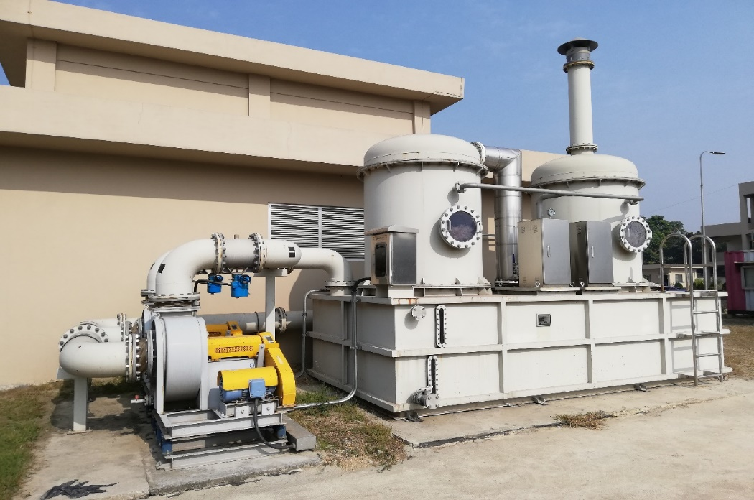
NEUTRALIZATION PLANT
Chlorine: Poisonous Gas
Chlorine Leak Detection System
Caustic Soda (NaOH) for Chlorine Neutralization
2NaOH + Cl₂ = NaOCl + NaCl + H₂O

Slide 12
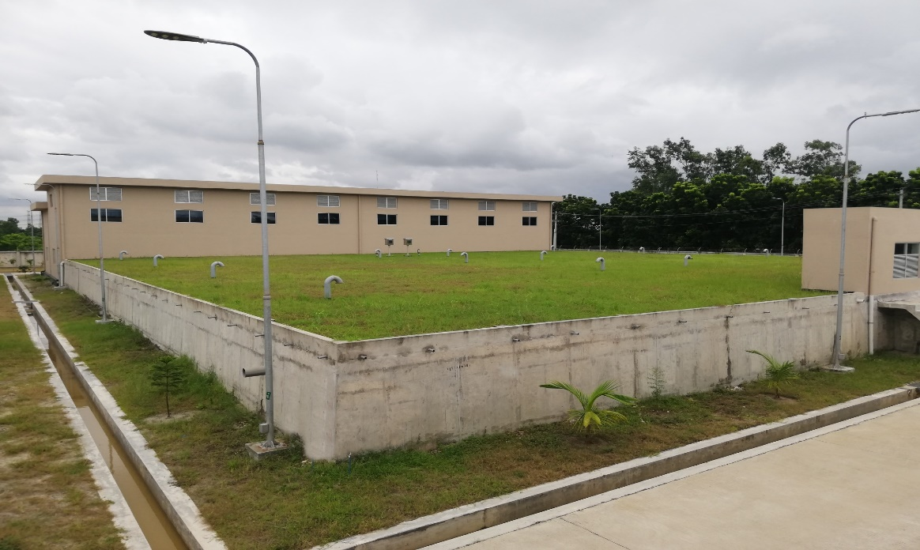
OVER GROUND RESERVOIR (OGR)
Stores Treated Water from IRPs.
Divided into 2 parts
Each Size: 42.3x20x5 m
Water Holding Capacity: 2x4,230 m³ = 8,460 m³

Slide 13
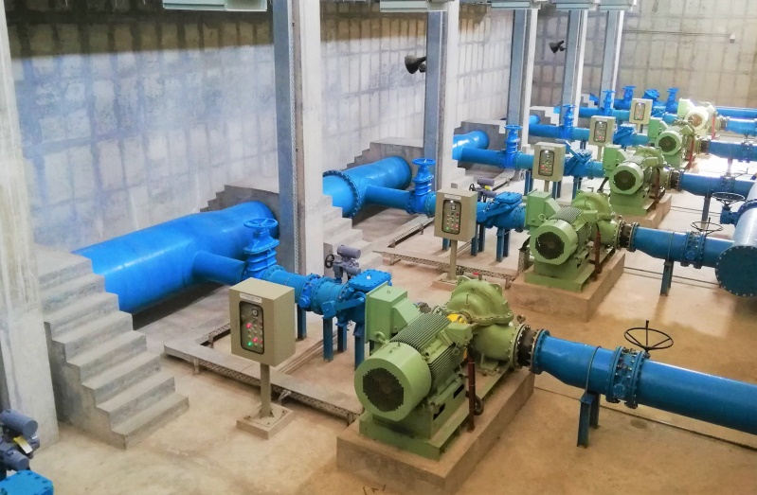
DISTRIBUTION PUMP
Pumps Treated Water to Transmission Network
Double Suction Centrifugal Pump
6 Sets (4 Duty+2 Standby)
Each Design Capacity: 1,600m³/hr.
Each Design Head: 45m
Motor Power Rating: 280kW

Slide 14
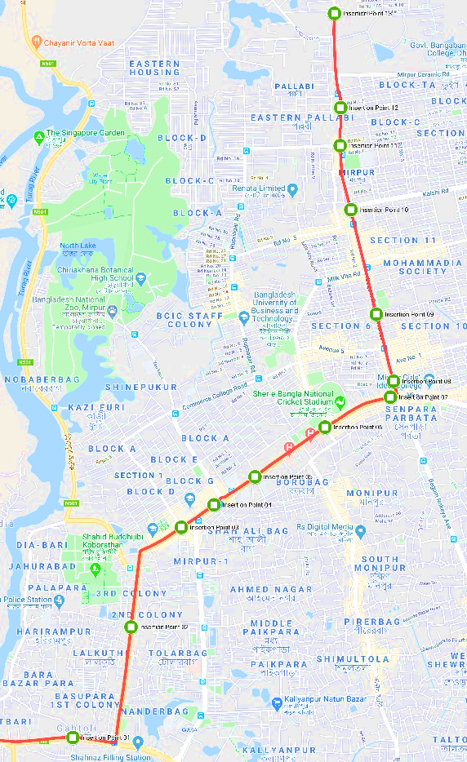
TRANSMISSION NETWORK
13.2 km Long Transmission Network
Pipe Diameter: 1200mm to 600mm
13 no’s Nodal Points with Chambers
Air Release Valve: 13 no’s
Butterfly Gate Valve: 5 no’s
Wash Out: 3 no’s

Slide 15
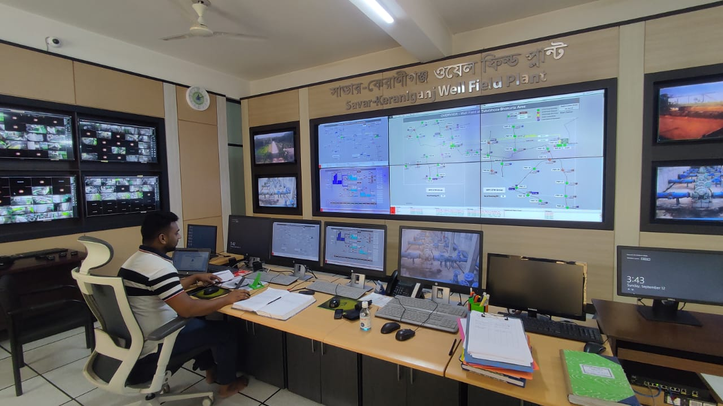
CENTRAL SCADA SYSTEM
Savar Keraniganj Wellfield Plant
is the most modern water Iron Removal Plant of Dhaka WASA.
Dhaka WASA Central SCADA system is developed day by day, following the foundation of Savar keraniganj wellfield Plant SCADA system.

Slide 16


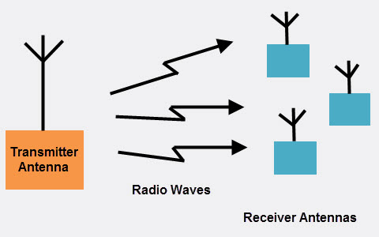
MOST ADVANCED SCADA SYSTEM SAVAR KERANIGANJ WELL-FIELD PLANT(SKWP)
Cost Free Communication Between NOC to RTU
Fully Automated System using AI
Latest Technology

Slide 17
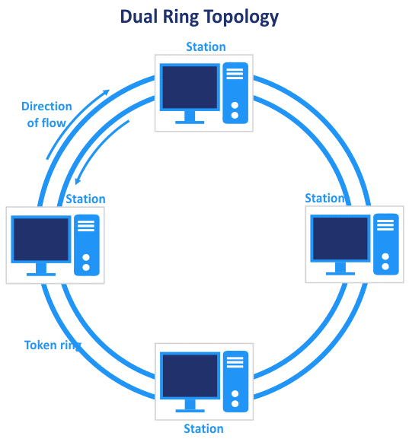
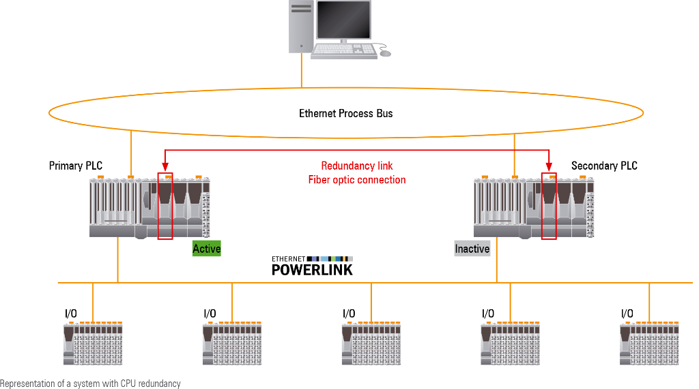
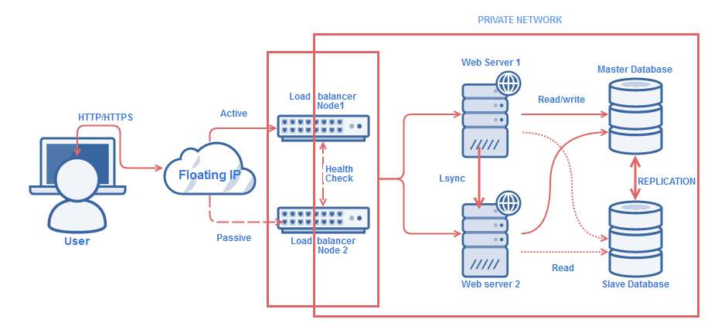
MOST ADVANCED SCADA SYSTEM SAVAR KERANIGANJ WELL-FIELD PLANT(SKWP)
Redundant PLC
Redundant Server
Dual Ring Topology

Slide 18
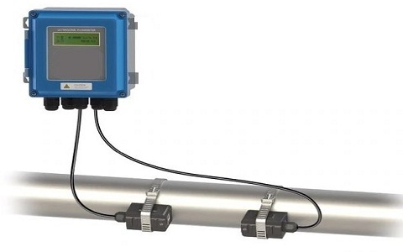
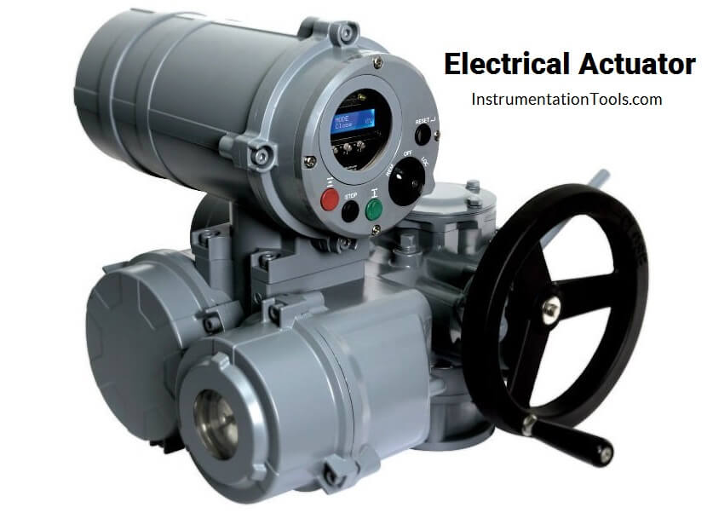
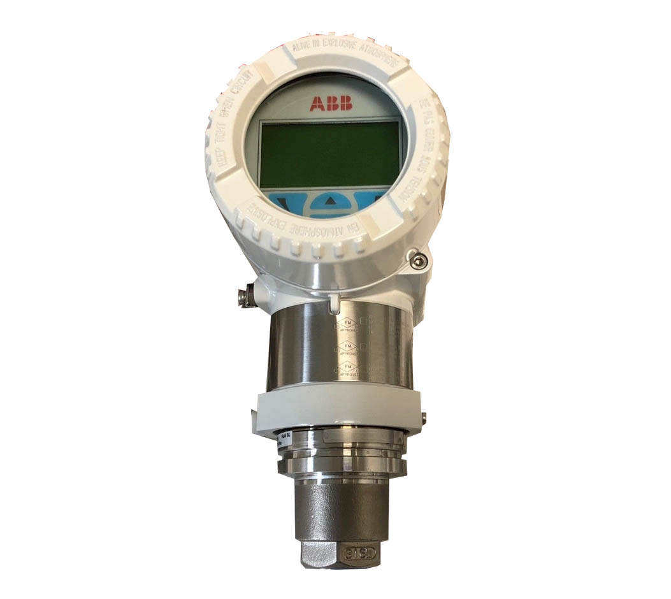
MOST ADVANCED SCADA SYSTEM SAVAR KERANIGANJ WELL-FIELD PLANT(SKWP)
Plant Based Equipment Parameter
Ultrasonic Flow Indicator Transmitter
Ultrasonic Level Transmitter
Pressure Indicator Transmitter
Variable Frequency Drive
Uninterrupted Power Supply
Under Voltage Relay
Earth Leakage Detector
Radio Communication
Motor Operating Valve (MOV)
Generator Status
Electrical System Monitoring
Chlorine Dosing System
Etc.

Slide 19
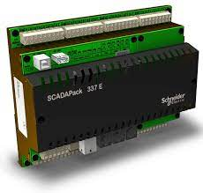
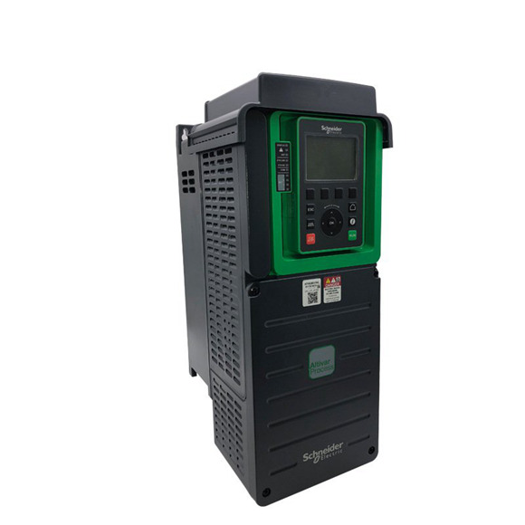
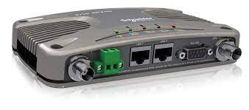
MOST ADVANCED SCADA SYSTEM SAVAR KERANIGANJ WELL-FIELD PLANT(SKWP)
DTW Based Equipment Parameter
Remote Terminal Unit
Flow Indicator Transmitter
Level Indicator Transmitter
Pressure Indicator Transmitter
Variable Frequency Drive
Uninterrupted Power Supply
Under Voltage Relay
Earth Leakage Detector
Radio Communication
Generator Status
Electrical System Monitoring
Etc.

Slide 20

CLEAR SCADA SYESTEM OVERVIEW

Slide 21
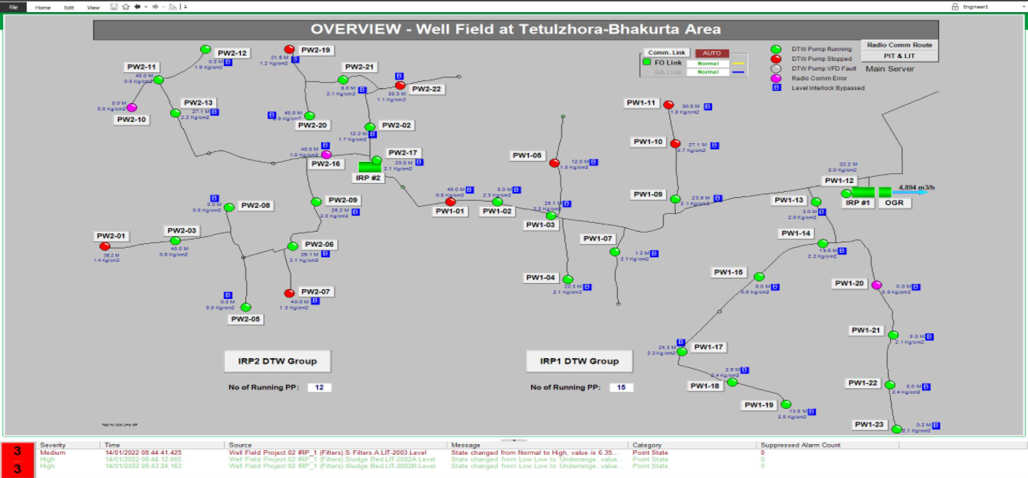
OVERVIEW

Slide 22
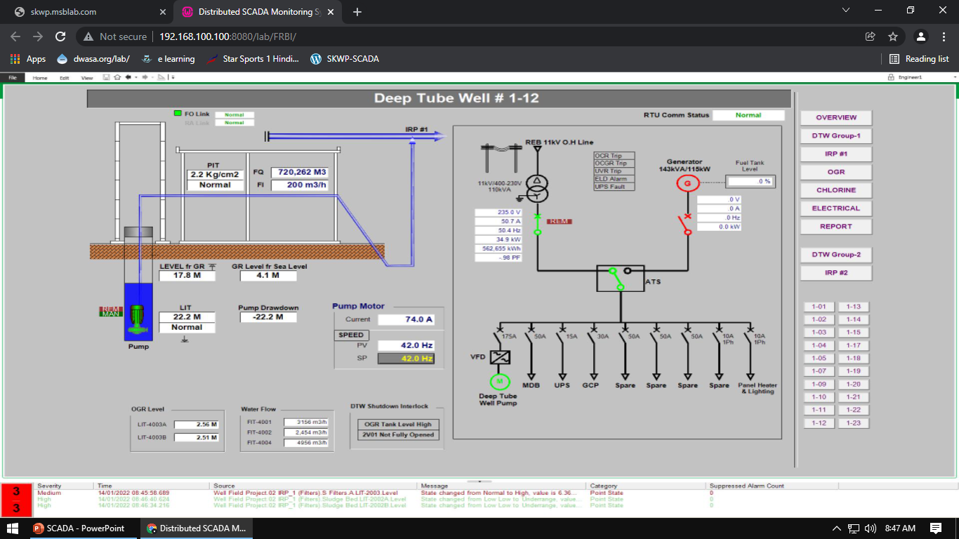
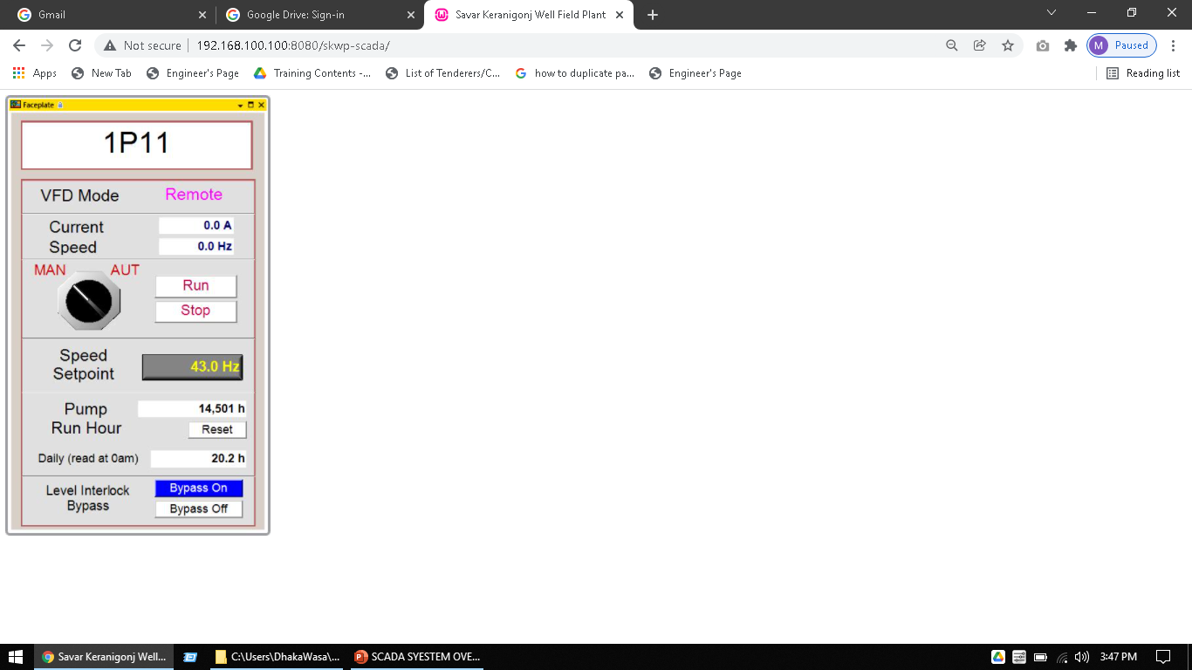
DEEP TUBE WELL 1-12

Slide 23
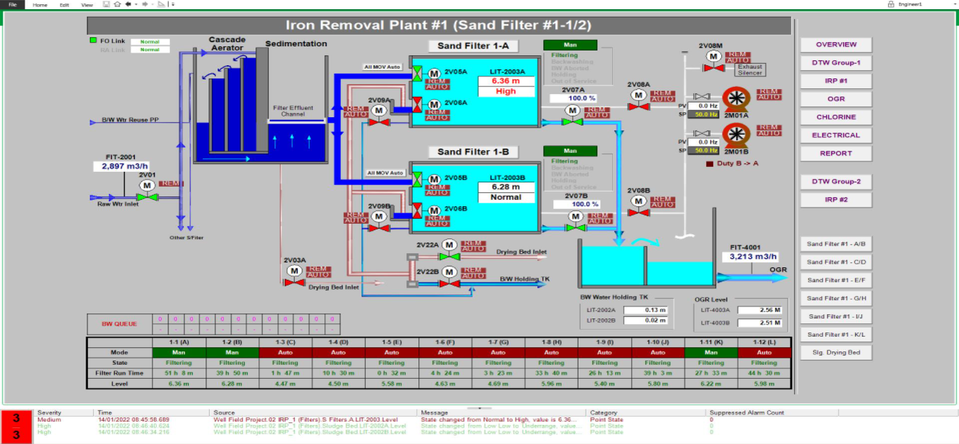
SAND FILTER IRP-1

Slide 24
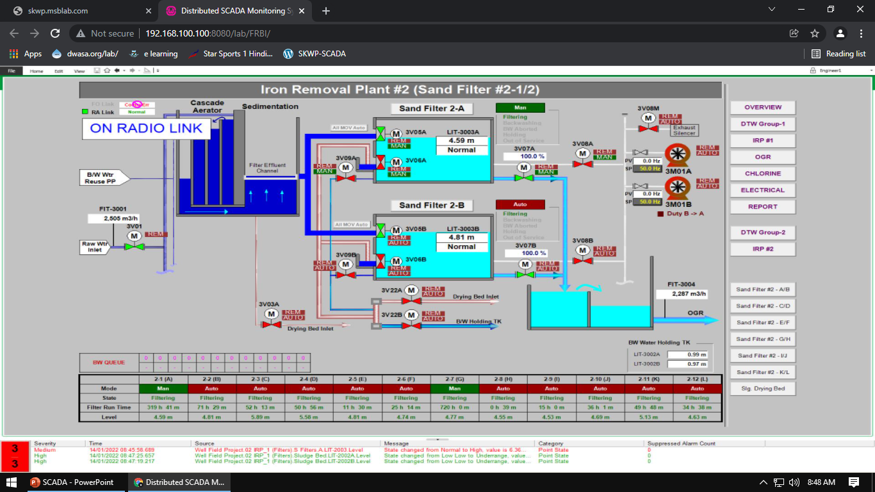
SAND FILTER IRP-2

Slide 25
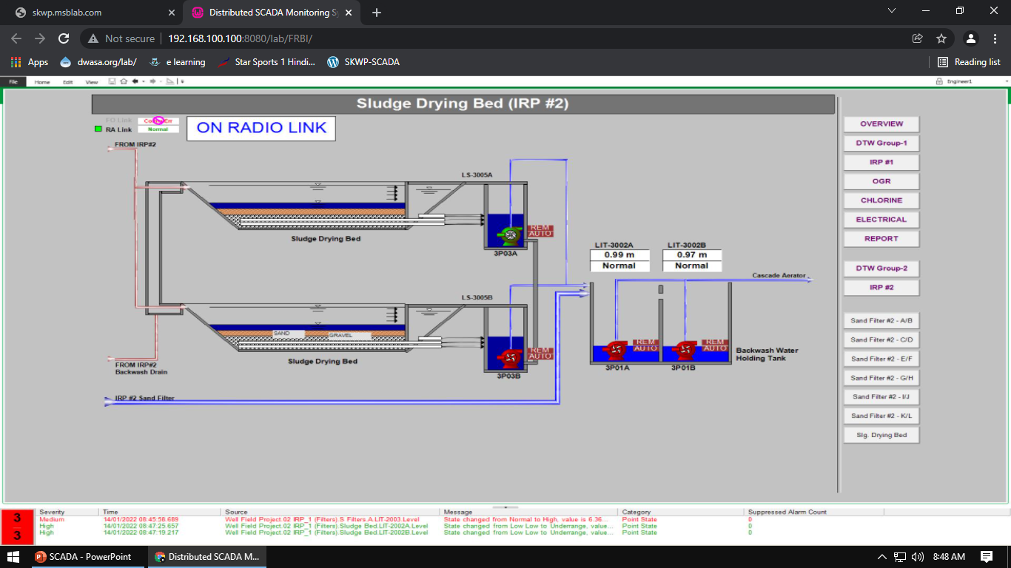
SLUDGE DRYING BED

Slide 26
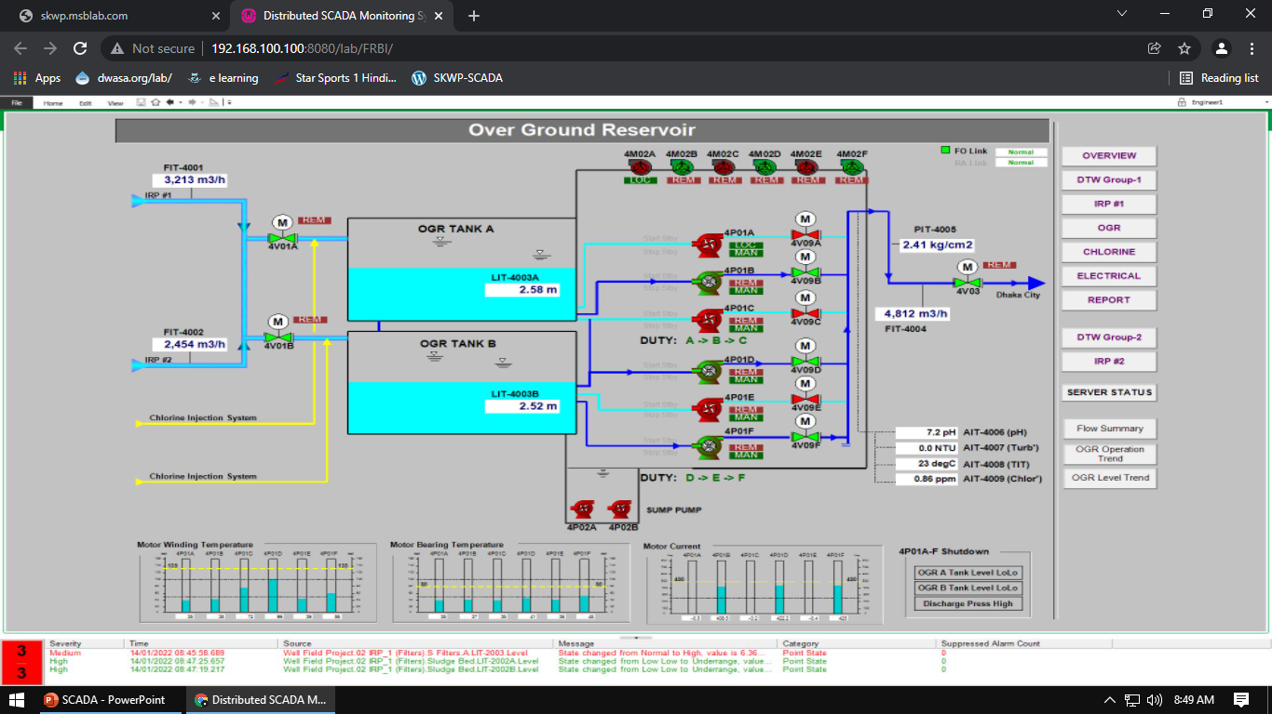
OVER GROUND RESERVOIR
Booster Pump

Slide 27
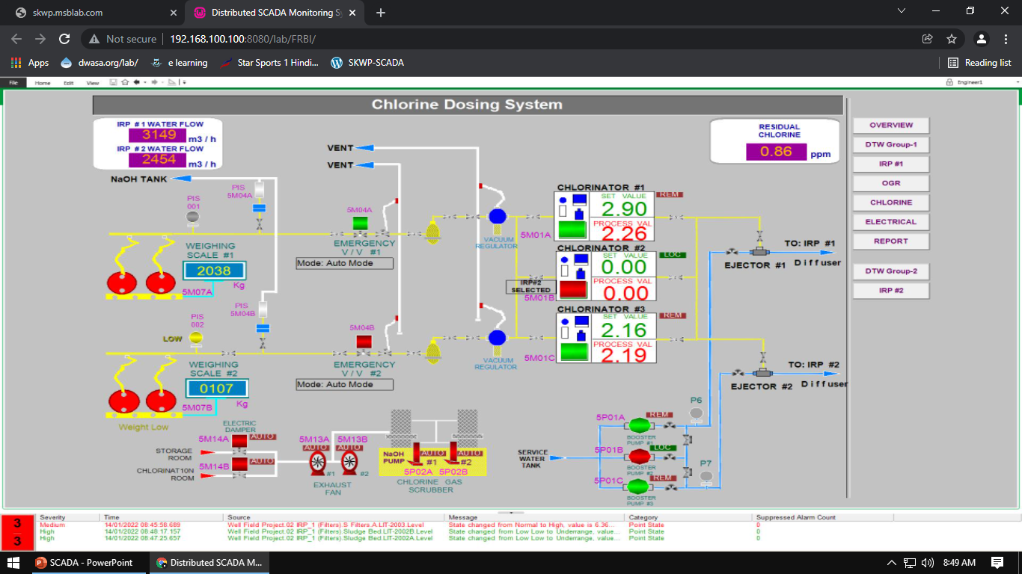
CHLORINE DOSING SYSTEM

Slide 28
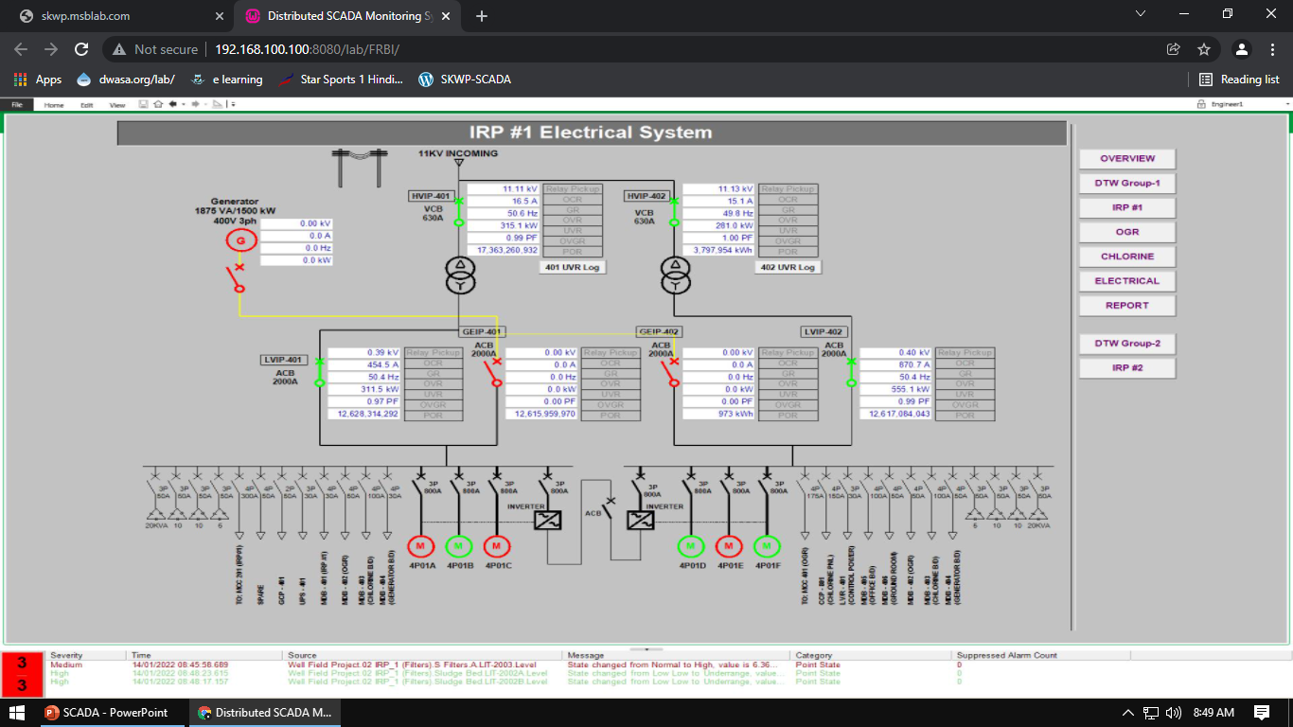
ELECTRICAL SYSTEM

Slide 29
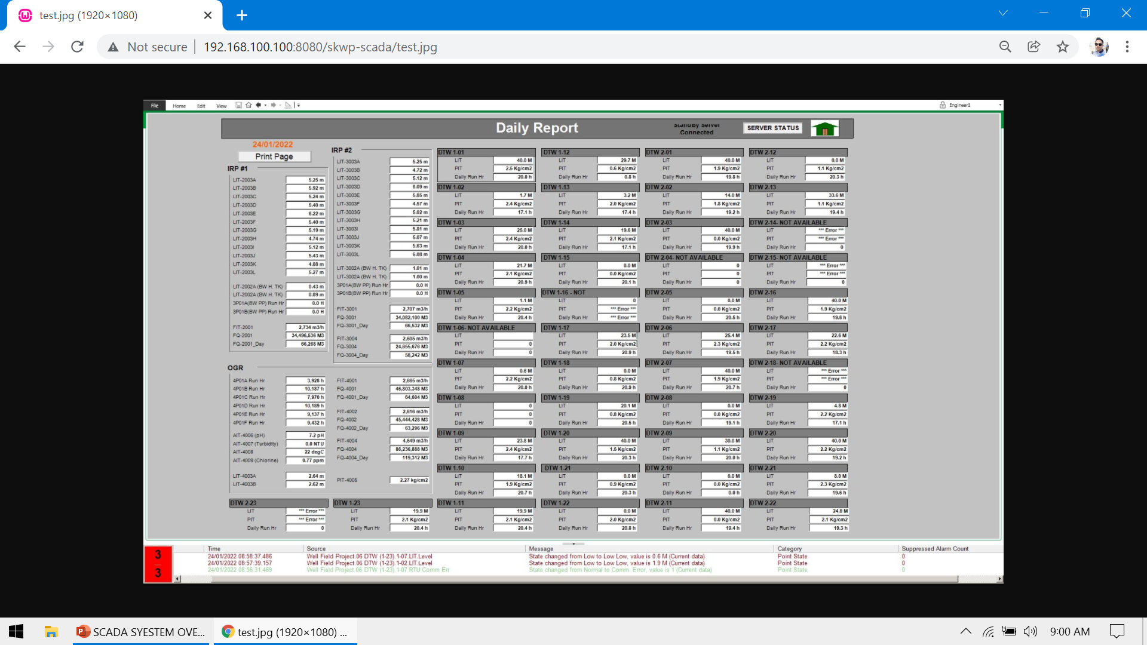
AUTOMATICALLY GENARATED REPORTING SYSTEM

Slide 30


CONCLUSION
Why is automation necessary?
Advantages commonly attributed to automation include higher production rates and increased productivity, more efficient use of equipment's, better product quality, improved safety, shorter workweeks for labor, and reduced factory lead times. Worker safety is an important reason for automating an industrial operation.
How is automation useful in future?
Automation has shown significant progression and that is now consistently present in various fields. There are ongoing concerns that automation will replace jobs in some industries; however evidence suggests it can also create new jobs and steer people towards other opportunities.

Slide 31
THANK YOU

